Slide 1
DEEP LEARNING WITH TENSORFLOW

Slide 2
Neural Networks
Interconnected units (neurons)
Activation signal(s)
Information processing
Learning involves adjustments to the synaptic connections

Slide 3
Supervised learning
Neural networks learn via supervised learning
Classification, regression
Label, target value
Training & Validation phases

Slide 4
Unsupervised learning
Clustering, feature selection
Finding structure of data
Statistical values describing the data

Slide 5

Supervised Machine Learning workflow
Clean data
Preprocess
data
Data split
Training data
Test data
Machine Learning
algorithm
Evaluation
Trained model

Slide 6
Types of Neural networks
There are seven types of neural networks that can be used.
The first is a multilayer perceptron which has three or more layers and uses a nonlinear activation function.
The second is the convolutional neural network that uses a variation of the multilayer perceptrons.
The third is the recursive neural network that uses weights to make structured predictions.
The fourth is a recurrent neural network that makes connections between the neurons in a directed cycle. The long short-term memory neural network uses the recurrent neural network architecture and does not use activation function.
The final two are sequence to sequence modules which uses two recurrent networks and shallow neural networks which produces a vector space from an amount of text.

Slide 7
Elements of neural networks
Input Layer :- This layer accepts input features. It provides information from the outside world to the network, no computation is performed at this layer, nodes here just pass on the information(features) to the hidden layer.
Hidden Layer :- Nodes of this layer are not exposed to the outer world, they are the part of the abstraction provided by any neural network. Hidden layer performs all sort of computation on the features entered through the input layer and transfer the result to the output layer.
Output Layer :- This layer bring up the information learned by the network to the outer world.

Slide 8
Activation functions
What is activation function?
Activation function decides, whether a neuron should be activated or not by calculating weighted sum and further adding bias with it. The purpose of the activation function is to introduce non-linearity into the output of a neuron.
Neural network has neurons that work in correspondence of weight, bias and their respective activation function. In a neural network, we would update the weights and biases of the neurons on the basis of the error at the output. This process is known as back-propagation. Activation functions make the back-propagation possible since the gradients are supplied along with the error to update the weights and biases.

Slide 9
Why we use activation function with neural networks?
It is used to determine the output of neural network like yes or no.
It maps the resulting values in between 0 to 1 or -1 to 1etc.(depending upon the function)
The Activation Functions can be basically divided into 2 types:
Linear Activation Function
Non-linear Activation Functions

Slide 10
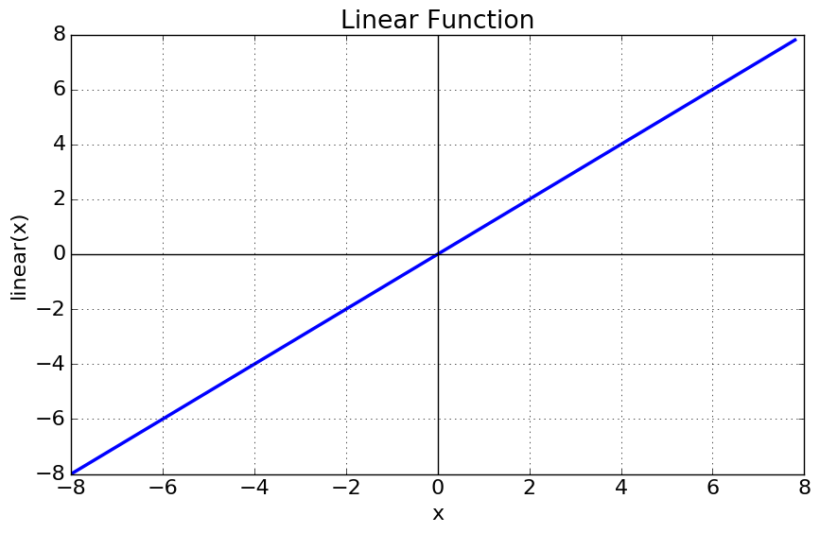
Linear or Identity Activation Function
Equation : f(x) = x
Range : (-infinity to infinity)

Slide 11
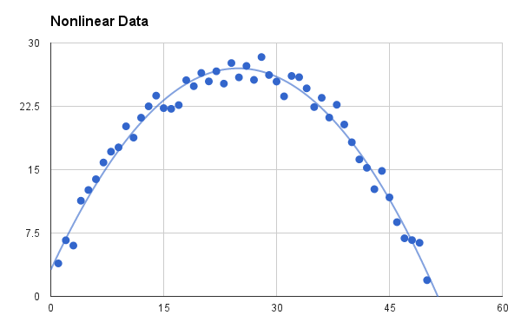
Non-linear Activation Function

Slide 12
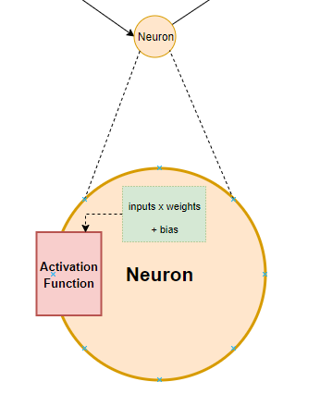

Weight and Bias
Weights are the co-efficients of the equation which you are trying to resolve.
The weight shows the effectiveness of a particular input. More the weight of input, more it will have impact on network.
How it works?

Slide 13
Bias
Bias is like the intercept added in a linear equation.
Bias is a constant value (or a constant vector) that is added to the product of inputs and weights.

Slide 14
Forward Propagation
As the name suggests, the input data is fed in the forward direction through the network.
Why Feed-forward network?
In order to generate some output, the input data should be fed in the forward direction only.
The feed-forward network helps in forward propagation.

Slide 15
Processing
Preactivation: It is a weighted sum of inputs i.e. the linear transformation of weights w.r.t to inputs available.
Activation: The calculated weighted sum of inputs is passed to the activation function. An activation function is a mathematical function which adds non-linearity to the network.
Code Optimization
Instead of using different variables like w1, w2…w6, a1, a2, h1, h2, etc. separately, a vectorized matrix can be used for weights, preactivation(a) and activation(h) respectively.

Slide 16
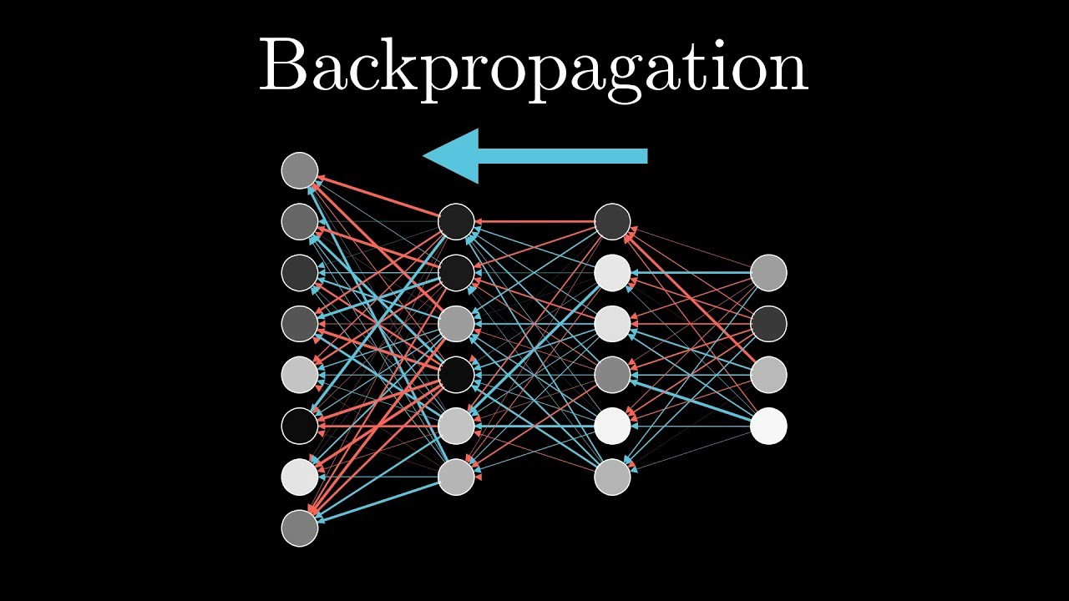
Backward Propagation
Back-propagation is the essence of neural net training. It is the practice of fine-tuning the weights of a neural net based on the error rate (i.e. loss) obtained in the previous epoch (i.e. iteration). Proper tuning of the weights ensures lower error rates, making the model reliable by increasing its generalization.

Slide 17
How it works?
Step – 1: Forward Propagation
Step – 2: Backward Propagation
Step – 3: Putting all the values together and calculating the updated weight value
Types of Backpropagation Networks
Static Back-propagation
Recurrent Backpropagation

Slide 18
Loss Function
The function we want to minimize or maximize is called the objective function or criterion. When we are minimizing it, we may also call it the cost function, loss function, or error function.
Loss Functions:
1.Regression Loss Functions
2.Binary Classification Loss Functions
3. Multi-Class Classification Loss Functions

Slide 19
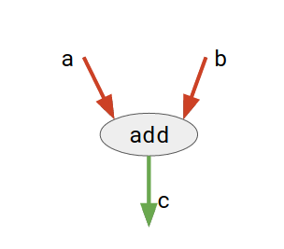
Introduction to TensorFlow
TensorFlow is basically a software library for numerical computation using data flow graphs where:
nodes in the graph represent mathematical operations.
edges in the graph represent the multidimensional data arrays (called tensors) communicated between them. (Please note that tensor is the central unit of data in TensorFlow).
For example,

Slide 20
TensorFlow APIs
Low level API:
complete programming control
recommended for machine learning researchers
provides fine levels of control over the models
High level API:
built on top of TensorFlow Core
easier to learn and use than TensorFlow Core
make repetitive tasks easier and more consistent between different users

Slide 21
Basics of TensorFlow core
Installing TensorFlow:
import tensorflow as tf
The Computational Graph
1.Building
2.Running
Variables
They are mainly used to hold and update parameters of a training model.
Placeholders
A graph can be parameterized to accept external inputs, known as placeholders. A placeholder is a promise to provide a value later.

